Slide 1
RMIT Property Services Group (PSG)
Permit Application Process

Slide 2
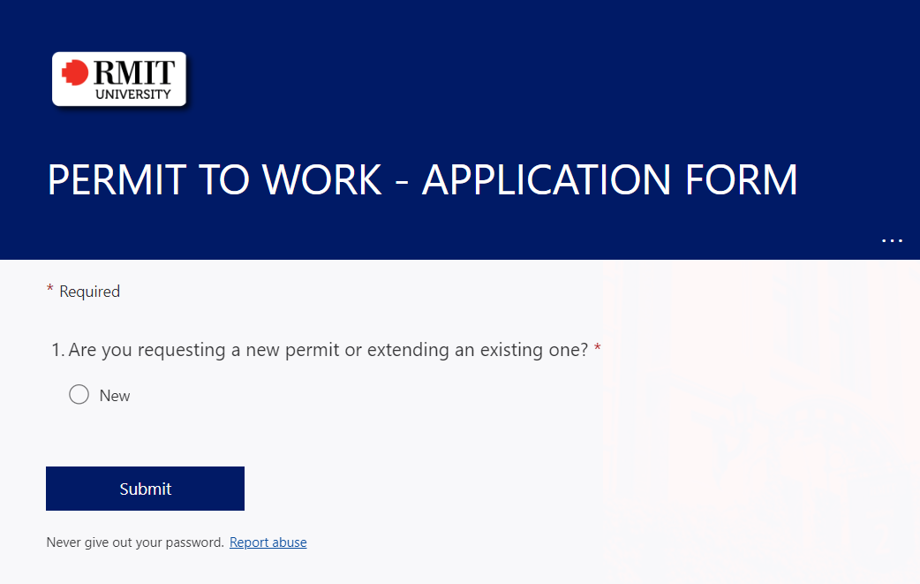
1.
Fill out the Microsoft Form to commence first part of permit application process
PTW Microsoft Form: https://forms.office.com/Pages/ResponsePage.aspx?id=cTYy0b7NF0S01L2yS1Exa_DlA46_sCNBqSFwzsw2vZJUMFRLS01HS05DNTg3QlQ2NDVOUDZOSEhXMSQlQCN0PWcu

Slide 3
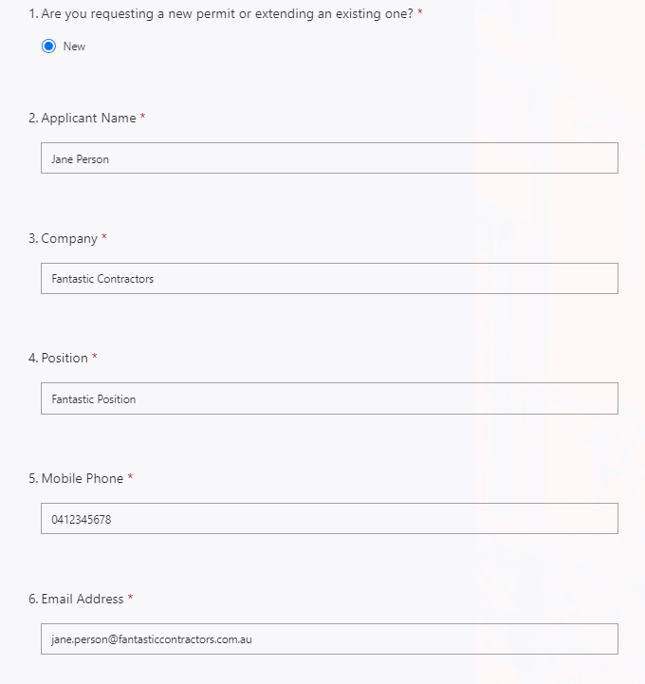
2.
Fill out Permit Application Form and
Ensure you email address is correct otherwise you won’t receive an email for the next step.

Slide 4
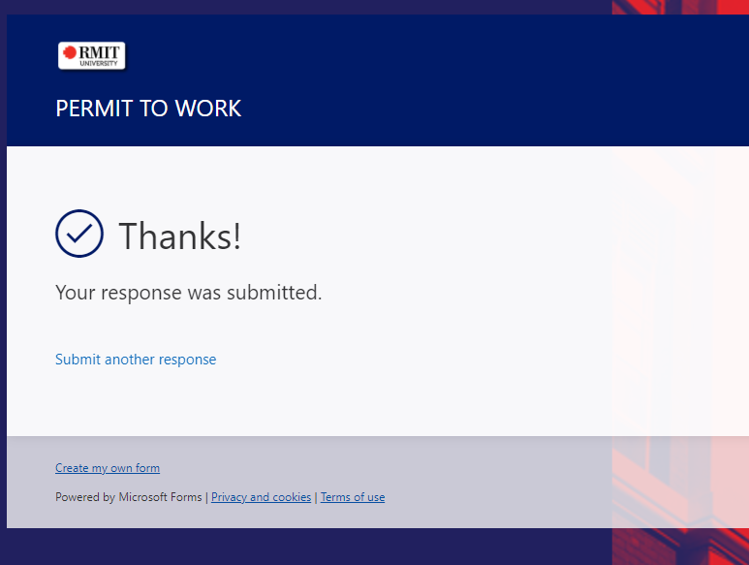
3.
Check details are Correct and click “Submit”

Slide 5
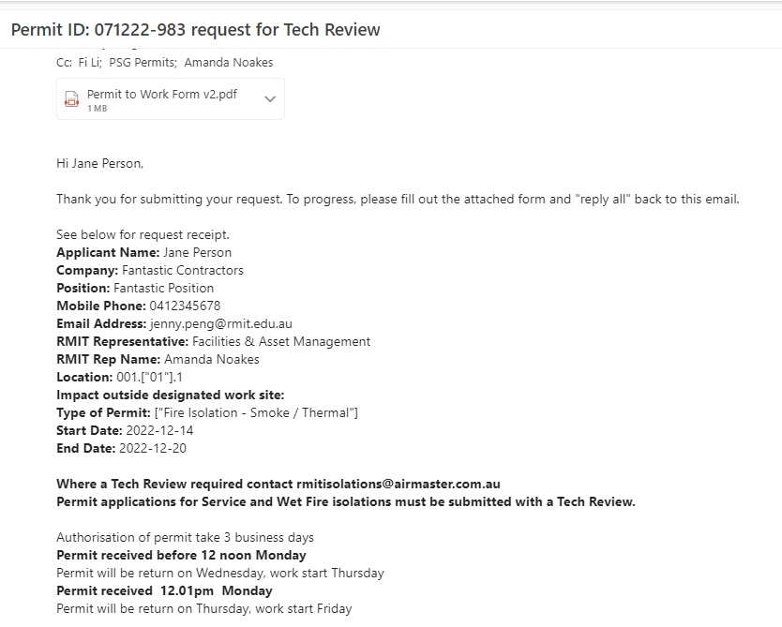
4.
You will get a return email that verifies details of permit request and includes a PDF version of the Permit To Work form for your to fill out.

Slide 6
5.
Note the following:
Unique Permit ID
Permit to Work Form PDF attachment
“Reply all” instruction
Tech Review requirement

Slide 7
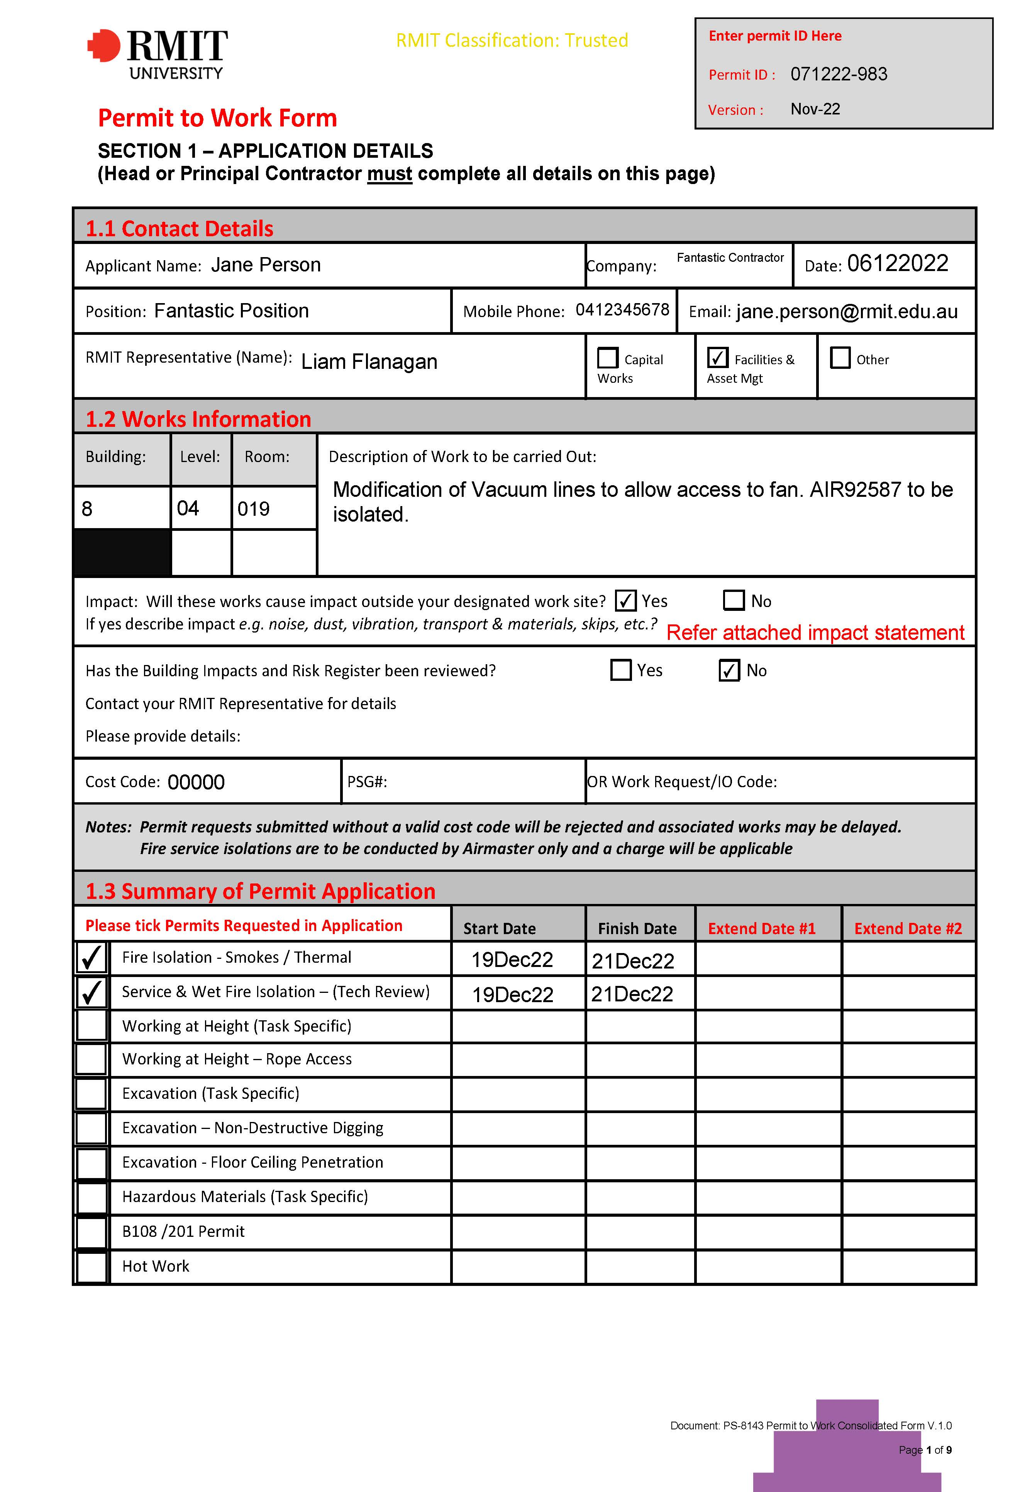
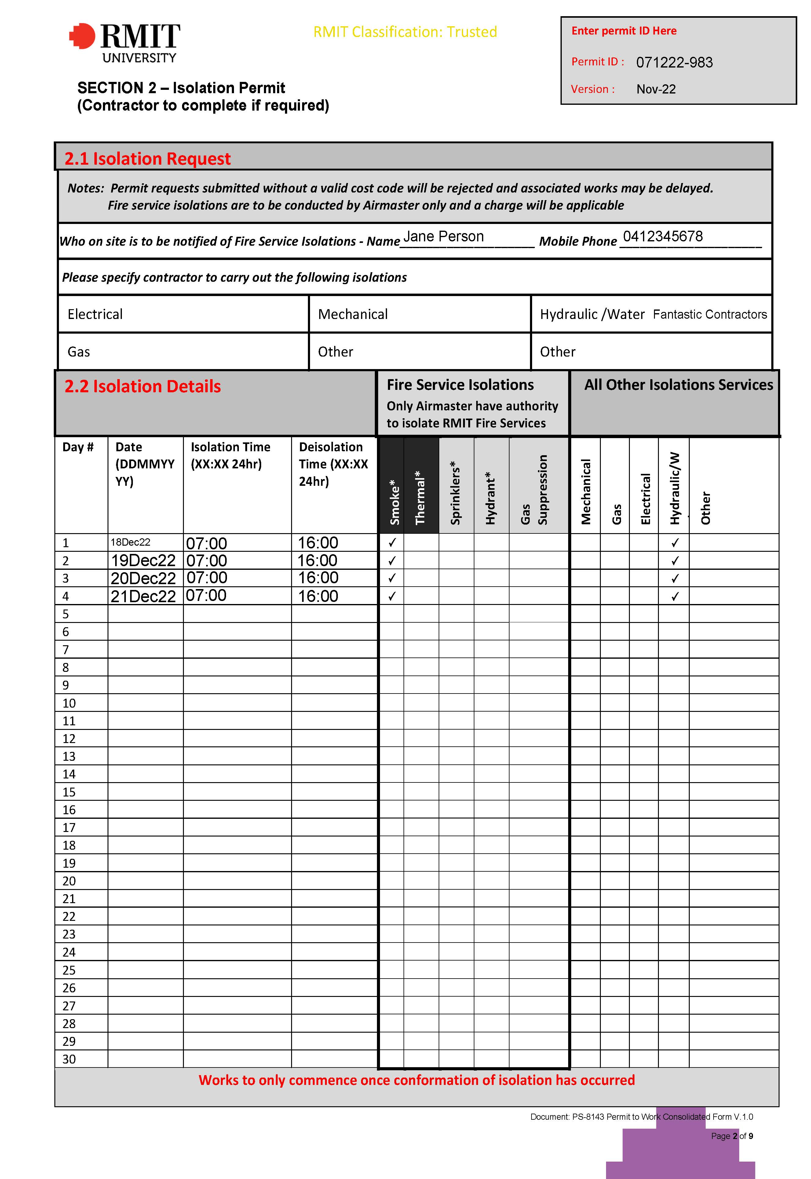
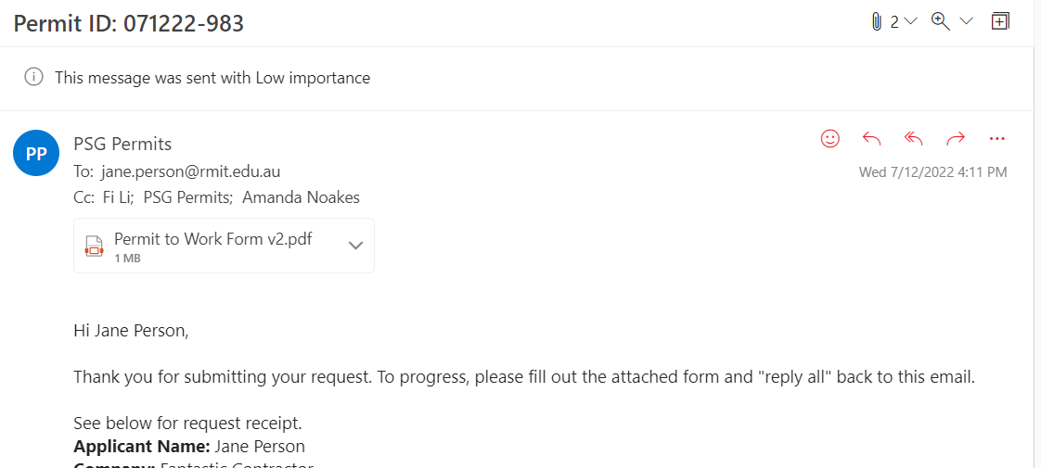
6.
Open the Permit to Work Form PDF attachment and fill out applicable areas

Slide 8
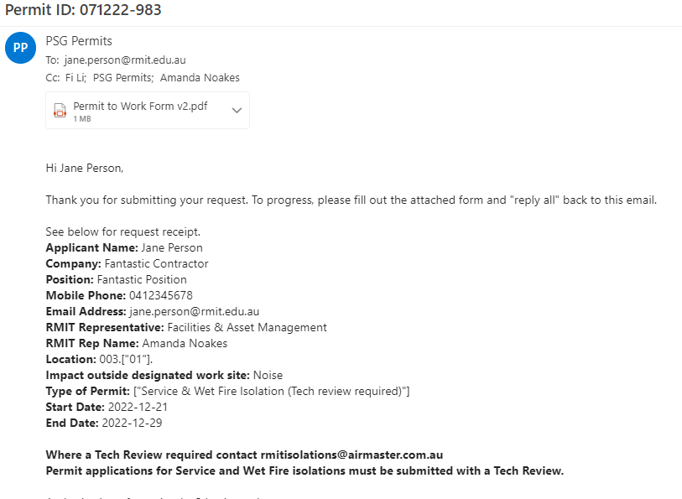
7a.
Tech Reviews are required for all isolations requests besides smoke and thermal isolations.

Slide 9
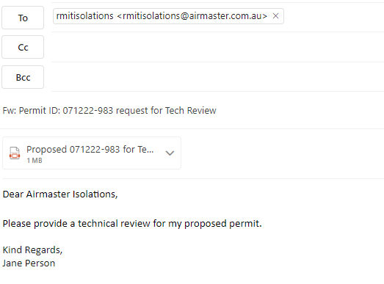
7b.
Email rmitisolations@airmaster.com.au for your permit Tech Review and email a copy of your preliminary permit.

Slide 10
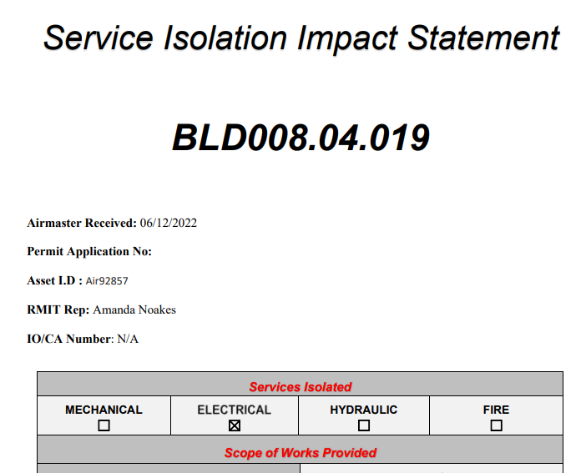
7c.
Upon receiving your Tech Review, amend your Permit Form per advice from rmitisolations@airmaster.com.au.
You must provide a cost-code from which isolations are charged to.
The Tech Review must be submitted with Permit to Work (PTW) form PDF to psgpermits@rmit.edu.au.

Slide 11
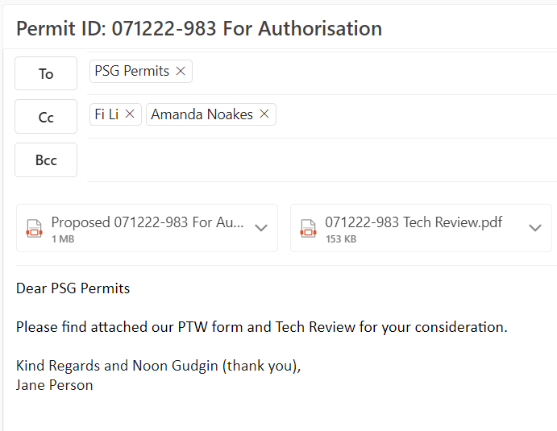
8.
Return your Permit To Work (PTW) form and supporting documents, including any Tech Reviews by “replying all” to your original permit email sent from psgpermits@rmit.edu.au.

Slide 12
9.
You will receive a response from psgpermits@rmit.edu.au within three business days or less.

